Slide 1

REN Package: Regularization Ensemble for Portfolio Optimization
Hardik & David
Notes:
“Good morning, everyone. I’m Hardik, and along with my partner Shijia, we are excited to present the REN Package—a sophisticated tool designed specifically for portfolio optimization. Today, we’ll explore the unique features of REN and discuss how it effectively addresses key challenges in portfolio optimization.”

Slide 2

KEY CHALLENGES IN PORTFOLIO OPTIMISATION
1
HIGH DIMENTIONALITY AND ESTIMATION ERRORS
Large portfolios lead to unreliable estimates of asset returns and covariance, causing poor out-of-sample performance.
2
STRONG CORRELATIONS BETWEEN ASSETS
Existing regularisation methods fail to handle highly correlated assets, leading to unstable or non- unique solutions.
3
POOR DIVERSIFICATION
Regularisation techniques often result in overly concentrated portfolios, reducing diversification and increasing risk.
Notes:
“When optimizing portfolios, we face three major issues:
High Dimensionality: Large portfolios make it hard to accurately estimate asset returns and covariance, leading to unreliable results.
Example: Imagine you’re managing a portfolio with 500 different stocks. Trying to predict how each stock will perform and how they interact with each other is like trying to predict the weather in 500 different cities at the same time. The more data points you have, the harder it becomes to make accurate predictions.
Strong Correlations: Many assets in a portfolio are often highly correlated, meaning they move in the same direction, making traditional methods unstable and producing non-unique solutions.
Example: Suppose you invest in five tech companies, and all of them tend to move in the same direction. If one stock drops, the others are likely to drop as well. This means your risk isn’t spread out because all your investments behave similarly.
Poor Diversification: Some regularization methods concentrate portfolios too much on a few assets, which increases risk.
Example: Think of investing only in one sector, like energy. If the energy sector crashes, your entire portfolio suffers. Diversification means spreading your investments across different sectors or types of assets, so you're not putting all your eggs in one basket.
These challenges can result in poor out-of-sample performance and increase the likelihood of taking on more risk than anticipated.”

Slide 3

SOLUTIONS BY REN
MANAGING HIGH DIMENSIONLAITY
CORRELATED ASSETS
1
2
REN divided assets into smaller, manageable subsets
(clusters), reducing dimensionality and improving estimation accuracy.
REN clusters assets by correlation and selects representatives from each cluster, creating more stable portfolios with lower within-portfolio correlations.
3
ENHANCING DIVERSIFICTAION
REN ensures better diversification and risk management by drawing assets from different clusters and constructing an ensemble of sub-portfolios.
Notes:
This is where REN comes in with innovative solutions, based on the research by Bonsoo Koo and Hong Wang, to tackle these problems:
To address high dimensionality, REN divides assets into smaller, more manageable clusters, improving estimation accuracy.
For strong correlations, REN groups assets based on their correlation structures and selects representative assets from each cluster. This reduces the internal correlation within the portfolio, making it more stable.
REN enhances diversification by creating an ensemble of sub-portfolios, each drawn from different clusters. This ensures better risk management and helps balance returns.

Slide 4
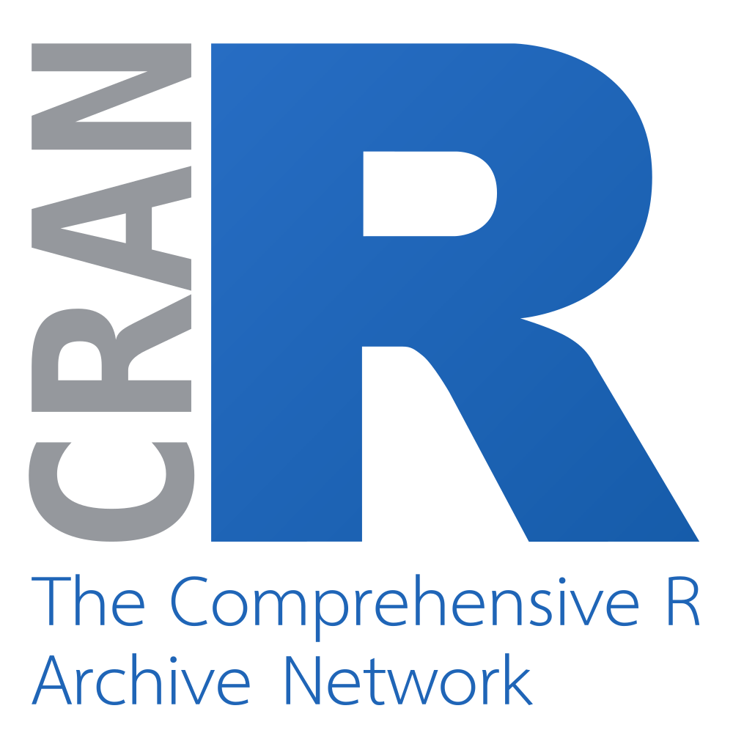

R PACKAGE - REN
REN is a cutting-edge R package designed for sophisticated portfolio optimization. It leverages regularization techniques and combines multiple optimized sub-portfolios to create diversified investment strategies.
REN's four key functions - prepare_data, setup_parallel, perform_analysis, and Ren (main function) - work synergistically to deliver robust financial analysis.
Notes:
The REN package is designed to make portfolio optimization easier and more effective. It combines regularization techniques with ensemble learning to create optimized sub-portfolios, which are then combined into a final, diversified portfolio. The package includes four main functions:
prepare_data: Cleans and prepares the data for modeling.
setup_parallel: Leverages parallel computing for faster performance.
perform_analysis: Analyzes portfolio performance using key financial metrics.
Ren (Main Function): The central function that integrates everything into a cohesive workflow.
With these tools, REN provides a streamlined way to manage portfolios and optimize performance while minimizing risk.”

Slide 5

Using REN with the FF25 Dataset
FF25 Overview
Correlation Analysis
The Fama-French dataset comprises 25 portfolios based on size and value of U.S. stocks.
REN identified asset clusters within FF25 based on their correlation structures.
Sub-Portfolio Creation
Ensemble Results
Optimized sub-portfolios were generated to maximize risk-adjusted returns.
The averaged portfolio demonstrated improved diversification and performance metrics.
Notes:
“We applied the REN package to the Fama-French 25 (FF25) dataset, which includes 25 portfolios based on U.S. stocks’ size and value. Here's what we did:
First, REN identified clusters of assets based on their correlations.
Then, sub-portfolios were optimized to maximize risk-adjusted returns.
Finally, these sub-portfolios were averaged, creating a diversified portfolio with improved performance metrics.
This method reduced the reliance on any single asset, helping us create a more stable and diversified portfolio.”

Slide 6




Data Preparation: The Foundation of Accurate Analysis
Data Cleaning
REN employs rigorous processes to handle missing values and align time series data. This ensures a clean, consistent dataset for optimization.
1
Feature Extraction
2
The package calculates log-returns and extracts relevant features. This prepares the data for sophisticated modeling and analysis.
Quality Assurance
3
Thorough checks are performed to ensure data integrity. This guarantees the suitability of inputs for accurate model calculations.
Notes:
“A key part of REN’s success is how well it handles data preparation. Before we can optimize a portfolio, we need clean, consistent data. Here’s how REN prepares the data:
Data Cleaning: It ensures missing values are handled properly and time series are aligned, so the data is clean and ready for modeling.
Feature Extraction: REN calculates log-returns and other relevant features to ensure sophisticated modeling and analysis.
Quality Assurance: REN performs thorough data checks to guarantee accuracy, ensuring reliable portfolio optimization.”

Slide 7




Parallel Computing: Optimizing Performance
Multi-Core Processing
Accelerated Optimization
Large Dataset Handling
REN distributes tasks across multiple CPU cores for efficient computation.
Parallel computing significantly reduces time for model fitting and portfolio optimization.
Efficient processing of extensive financial datasets enhances scalability.
Notes:
“One of the standout features of the REN package is its use of parallel computing.
This allows REN to handle large datasets efficiently by distributing tasks across multiple CPU cores, significantly speeding up the optimization process.
Not only does this make the package scalable, but it also reduces the time required for model fitting and portfolio analysis. So, even with extensive datasets, REN can deliver results faster and more effectively.”
Now shijia will take over from here .

Slide 8





Perform Analysis: Comprehensive Portfolio Evaluation
Sharpe Ratio
Volatility
Measures risk-adjusted returns, indicating portfolio efficiency. Higher ratios suggest superior risk-adjusted performance.
Assesses portfolio stability over time. Lower volatility indicates a more stable, less risky investment.
Maximum Drawdown
Turnover
Evaluates downside protection by measuring the largest peak-to-trough drop. Minimized drawdowns demonstrate effective risk management.
Measures how often a portfolio’s assets are traded over a period, reflecting the frequency of buying and selling activities.
Notes:
Thanks Hardik, Let’s now look at some of the key metrics we use to assess the performance of a portfolio. These metrics are essential for evaluating both the risk and returns of the portfolio.
The first one is Sharpe Ratio: This measures how much return we get for each unit of risk. A higher Sharpe ratio means the portfolio balances risk and return better.
The second one is Volatility, it shows how much a portfolio’s value goes up and down. Lower volatility means the portfolio is more stable, which investors prefer because it reduces the chance of big, sudden losses.
The third one is Maximum Drawdown: This measures the largest drop in portfolio value from its highest point. A smaller maximum drawdown means the portfolio holds its value better during tough times.
And lastly, Turnover shows how often the portfolio changes its holdings. High turnover can lead to higher costs, so it's important to keep turnover at a moderate level to balance performance and costs.
These metrics are important in evaluating the performance and risk management of any portfolio. By optimizing portfolios with the REN package, we aim to improve these metrics, ensuring a stable, efficient, and cost-effective investment strategy.

Slide 9
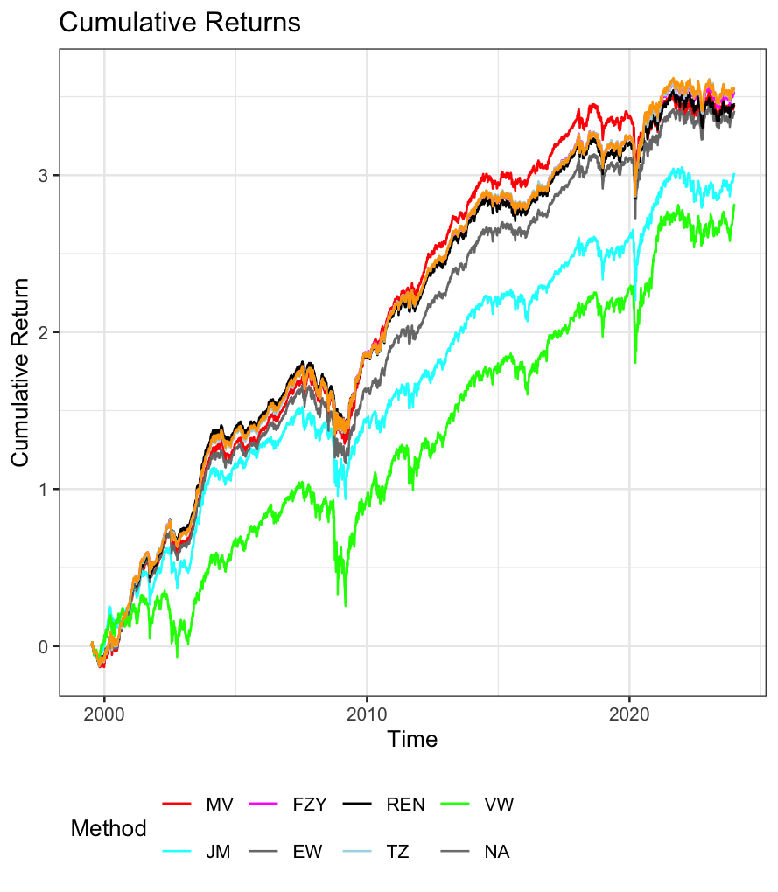
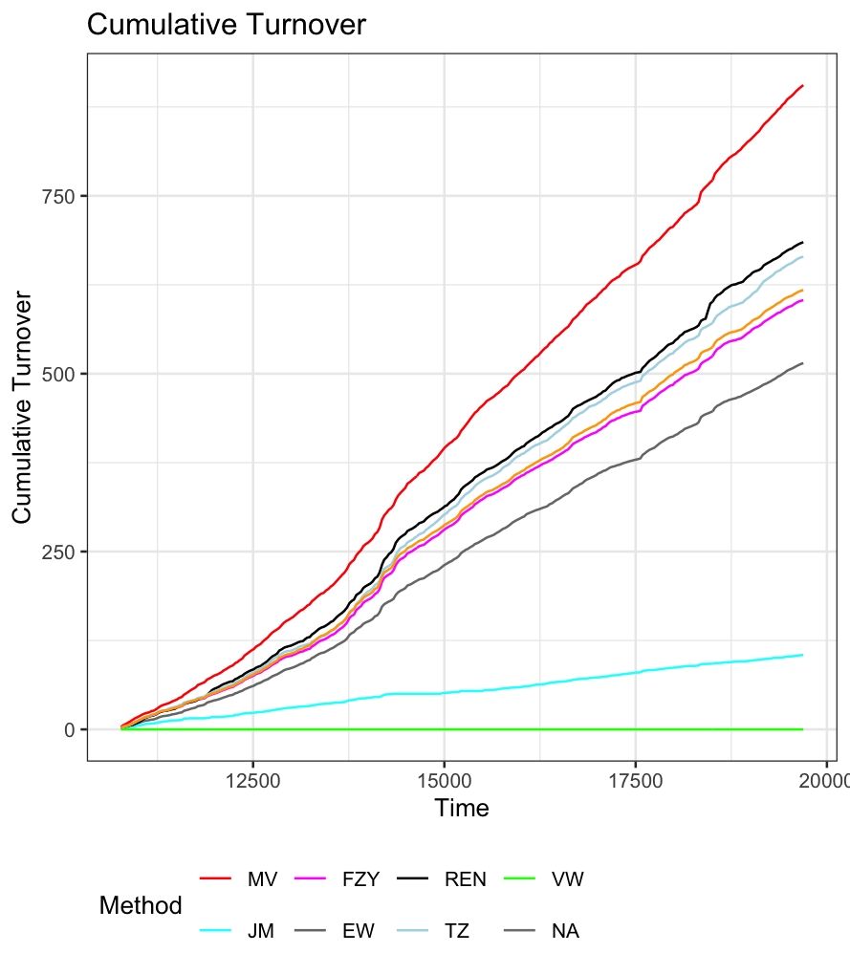
Performance Visualization
Cumulative Returns
Cumulative Turnover
Emphasize how the ensemble method reduces reliance on any single asset, leading to smoother and more consistent growth.
Highlight the importance of managing turnover to minimize transaction costs, which is achieved through regularization that focuses on key assets.
Notes:
Additionally to the metrics, we have also generated two plots, which are part of perform analysis function:
The plot on the left side is a Cumulative Returns Plot: This plot shows how the value of the portfolio grows over time. To create this, we used a method in the REN package that groups similar assets together. After each group is optimized, we combine these groups to make the final portfolio. This approach helps to spread out the risk, making the portfolio more stable and leading to consistent growth. The smooth line in the plot shows how this method reduces big swings in value by avoiding reliance on just a few assets.
The plot on the right side is a Cumulative Turnover Plot: it shows how often the portfolio's assets are bought and sold over time. Turnover affects how much it costs to manage the portfolio, since frequent trading can increase fees. This plot tracks the overall trading activity. The REN package uses techniques to limit how often assets need to be changed, keeping the turnover at a reasonable level. By doing this, we can lower costs while still keeping the portfolio well-balanced.
These two plots provide important insights into how the portfolio is performing. The cumulative returns plot shows the portfolio’s steady growth, helped by the REN package’s method of spreading out risk. The cumulative turnover plot shows the trading activity and helps us ensure that we’re keeping costs low by not trading too much. The REN package balances performance with efficient management, ensuring stability and minimizing unnecessary trading

Slide 10

Real-World Performance
1
Outperformance
2
Risk Management
Higher Sharpe Ratios
Lower Volatility
Better Maximum Drawdown
REN provides strong portfolio stability and risk reduction across varying market conditions.
3
Tested datasets
Fama-French portfolios
S&P 500
Russell Top 200.
Notes:
Now let’s talk about the real-world performance of the REN package, as stated in Bonsoo Koo and Hong Wang’s research paper.
The package was evaluated using real-world financial datasets, including the Fama-French portfolios, S&P 500, and the Russell Top 200 indices. These datasets represent actual financial market data and were used to see how well REN performs compared to other portfolio optimization strategies.
The results were impressive. REN consistently delivered higher Sharpe ratios, which means better risk-adjusted returns, while also achieving lower volatility—making the portfolios more stable. Additionally, REN showed a significant reduction in maximum drawdown, meaning it was better at minimizing losses during market downturns.
Overall, the research demonstrated that REN is highly effective in risk management and can be applied to real-world financial markets with strong performance results.

Slide 11
Demonstrate in R studio
Notes:
Lets take a look at the package itself, as Hardik mention earlier, the function has been divided into 3 functions and one main function.
The reason we chose to divide the package this way is to make the code more modular, flexible, and easier to maintain.
By separating the tasks into smaller functions, we ensure that each part of the process—data preparation, parallel processing, and analysis—can be worked on individually without affecting the entire workflow.
This makes it easier to debug, update, or reuse specific parts of the code. It also allows us to make adjustments to one function without disrupting the rest of the process.
When everything comes together in the main ren function, we get a clear and organized workflow.
The main function ren is what we use most of time, For example, if you want to analysis the FF25 data set, you can simply call dat(FF25), and it will be there in the environment. And we can pass the dataset into the function.
After running the function, you will be asked to set how many cpu cores you want to use, and then, the function will run by itself. For the FF25 data set, the function will run about 40 minutes, so, because of the time constraints, I will stop running for now. The plots are already showed in the power point earlier.
And one good news, our package is available on CRAN, every R user can simply download it from CRAN and use it.

Slide 12

Challenges in Package Development
Function loop bug, condition never meet.
pkgdown bug affected image paths, delaying our documentation efforts.
Issues with GitHub Actions setup required restructuring the repository.
Many small issues that seemed large at the time but were valuable learning experiences.
hd
Notes:
During the development of the REN package, we encountered a range of challenges, and I’d like to highlight a specific issue that caused some delays and how we resolved it.
We encountered an error with a function loop because a temporary variable wasn’t created or referenced correctly during the model-building process. It took some time to figure out since the problem wasn’t in the core logic but in how temporary files were handled.
To fix it, we updated the code to ensure all temporary variables, were properly created and used. And after making these changes, the package worked smoothly.
In addition to this, we also faced the pkgdown bug, which affected image paths, causing us unable to see the images on the website we generate, and when we setting up the GitHub Actions, it required some restructuring of our repository.
Although these issues seemed large at the time, overcoming them provided us with valuable learning experiences. It always makes me feel happy after seeing green ticks instead of red warnings or errors.

Slide 13

Conclusion:
1
Robust Solution
2
Improved Diversification
3
Educational Journey
REN combines regularization and ensemble learning for superior portfolio optimization. It enhances stability and performance in quantitative finance applications.
Despite challenges, the development process was highly rewarding. It provided insights into advanced financial modeling and software engineering practices.
The package offers better risk management through advanced diversification techniques. It adapts to various market conditions and asset classes.
Notes:
In conclusion, the REN package is a robust solution that combines regularization and ensemble learning to improve portfolio optimization. It provides enhanced stability, better diversification, and consistent outperformance in both risk management and returns.
Through our work, we’ve shown that REN is adaptable to different datasets and market conditions, making it a flexible tool in quantitative finance.
Although the journey was challenging, but it was also ultimately rewarding. We recevied deep insights into advanced financial modeling and package development.
thank you for your time, this is the end of our presentation.

